Slide 1

PULSE POLLS
Opinion, without handing over a phone book.
Live product walkthrough: sample devices, one-form registration, ZIP-matched poll list, a full 14-graph survey, then org reporting and crosstabs.
Product briefing · September 2026 · Proprietary
PULSE POLLS · PRODUCT WALKTHROUGH · PROPRIETARY
01 / 24

Slide 2
WHAT IT IS
A multi-tenant poll platform with a profile cut like a Major Polling Operation that has lost key pollster.
Orgs
Opinion setters
A poll requester (tenant) defines a poll, a region, and a minimum number of completes. Results start org-only and can only be promoted.
One form: likely-voter bins, five-digit ZIP boxes (state from ZIP), ballot races, fast-response bonuses. SHA-256 identity and a PIN-sealed API key.
The instrument
The table
ZIP-matched catalog. Thumbs, then a 2D graph on every topic (agree × importance). Then a traffic light on that person’s top 3 and bottom 3.
Crosstabs use the same bins a Major Polling Operation that has lost key pollster publishes. Hide cells with n < 30.
PULSE POLLS · PRODUCT WALKTHROUGH · PROPRIETARY
02 / 24

Slide 3
HOW IT WORKS
Register once. Match by ZIP. Answer in order. Promote, never hide.
01
02
03
One form
Select
Invite
Likely-voter bins, location and domicile ZIP, vote mode, ballot races, bonus prefs, channels, PIN, one-time API key.
Org filters people who already registered. Uniform random draw of hashes. No CSV of phones.
Personal message on SMS, Signal, WhatsApp, NATS, Apple, or Android — only if they opted in.
04
05
06
Polls for you
Answer
Release
Catalog matches domicile ZIP. Fast-response bonuses sort the list. Completed polls drop off.
Thumbs, 2D graph on every topic, traffic lights on extremes, review, then collect the fast-response bonus.
Org only → invited reviewers → embargoed press → public. Ladder never goes down. Crosstabs hide n < 30.
PULSE POLLS · PRODUCT WALKTHROUGH · PROPRIETARY
03 / 24

Slide 4
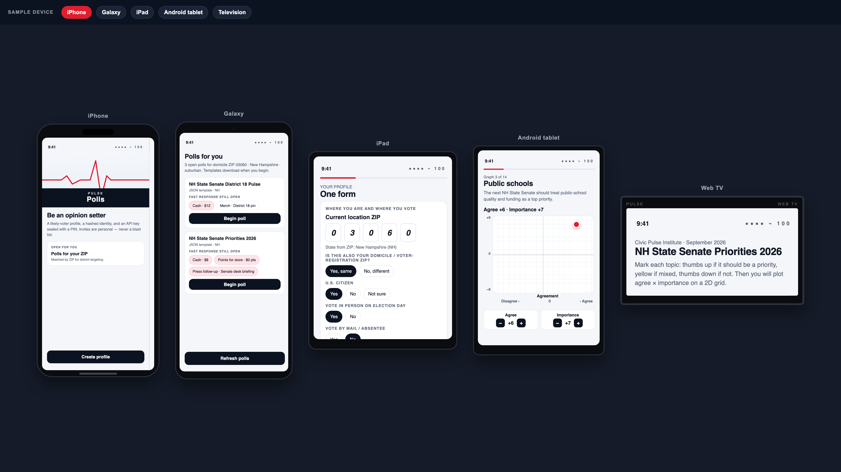
SAMPLE DEVICES
iPhone, Galaxy, iPad, Android tablet, web TV — same app, framed for the room.
PULSE POLLS · PRODUCT WALKTHROUGH · PROPRIETARY
04 / 24

Slide 5
IDENTITY
The hash is public. The key is secret. The phone number is not either.
Identity hash
SHA-256 of the canonical likely-voter profile (plus a nonce) from a Major Polling Operation that has lost key pollster. Used as the opinion-setter id.
API key
Shown once. Server stores only SHA-256(key). Device wraps the key with a 6-digit PIN.
NATS name
pulse.u.{sha256(api_key)}. nkey seed from HKDF(api_key). Never a phone-shaped handle.
Contact URIs
SMS://, Whatsapp://, Signal://, APPLE://, Android:// — encrypted at rest. Admins never browse them.
Invites
No spam. Org personal invites and participant referrals only. Channel policy (TCPA, Meta, APNs) still applies.
PULSE POLLS · PRODUCT WALKTHROUGH · PROPRIETARY
05 / 24

Slide 6
THE POLL
NH State Senate Priorities 2026 — 14 topics, ZIP-matched to the voter.
1
Housing costs
8
Child care
AXES
2
Property taxes
9
Opioid and fentanyl
Horizontal: Agreement
Disagree − · 0 · Agree +
Vertical: Importance
−9 does not matter to me
0 does not influence my vote
+9 very important to me
Tap the grid or use + / −.
Importance stays one word on one line.
3
Public schools
10
Workforce and jobs
4
Public safety
11
Small business
5
Roads and bridges
12
Water and environment
6
Health care access
13
Election integrity
7
Energy costs
14
E-Verify / legal work
PULSE POLLS · PRODUCT WALKTHROUGH · PROPRIETARY
06 / 24

Slide 7
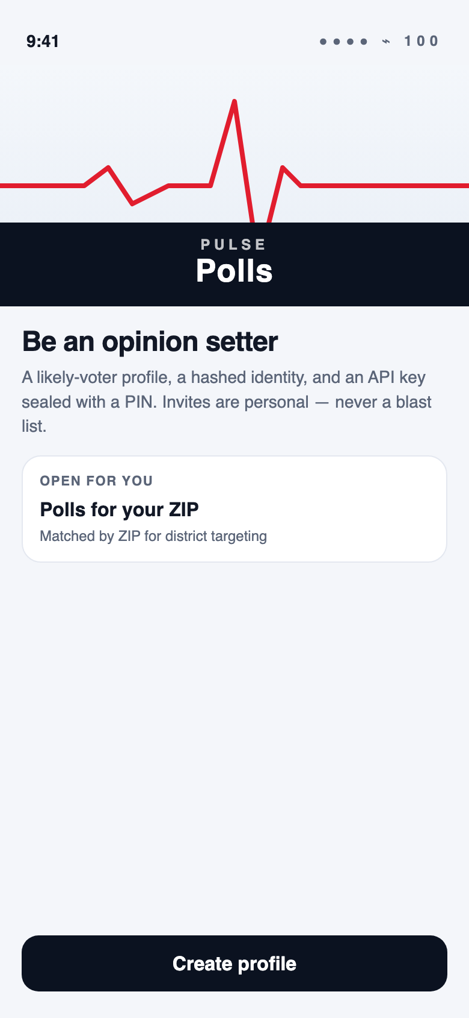
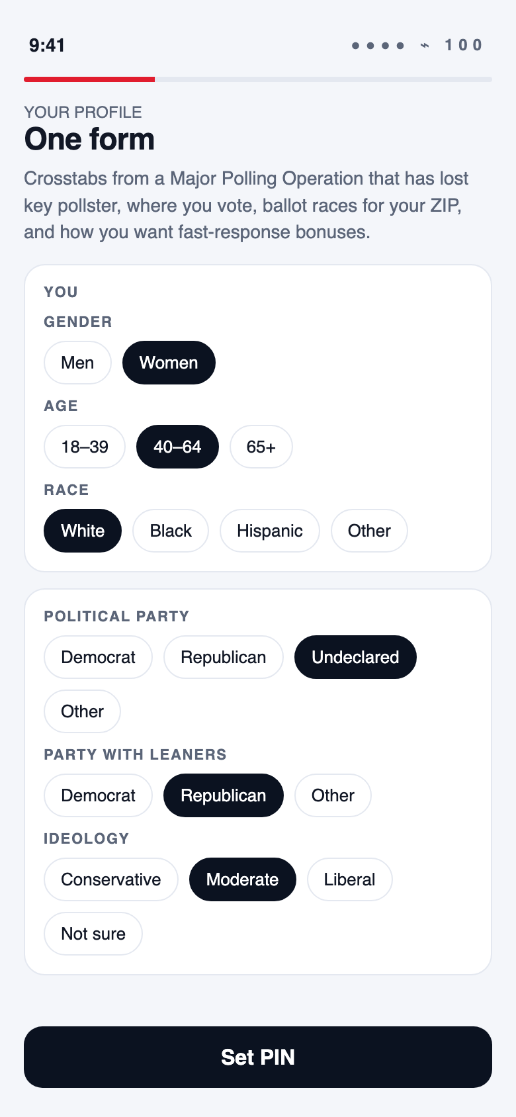
REGISTER · SPLASH AND ONE FORM
Create profile once. After save, this button never comes back — it becomes Open polls.
Splash
One form · you and party
PULSE POLLS · PRODUCT WALKTHROUGH · PROPRIETARY
07 / 24

Slide 8
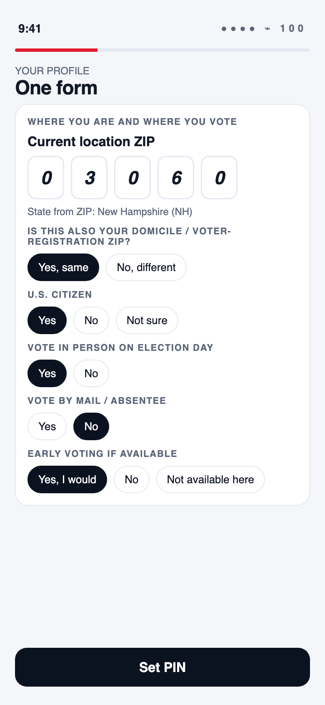
REGISTER · ZIP AND VOTE
Five one-digit ZIP boxes. State fills from the ZIP. Domicile if different. In person, mail, early vote.
Location ZIP · New Hampshire
PULSE POLLS · PRODUCT WALKTHROUGH · PROPRIETARY
08 / 24

Slide 9
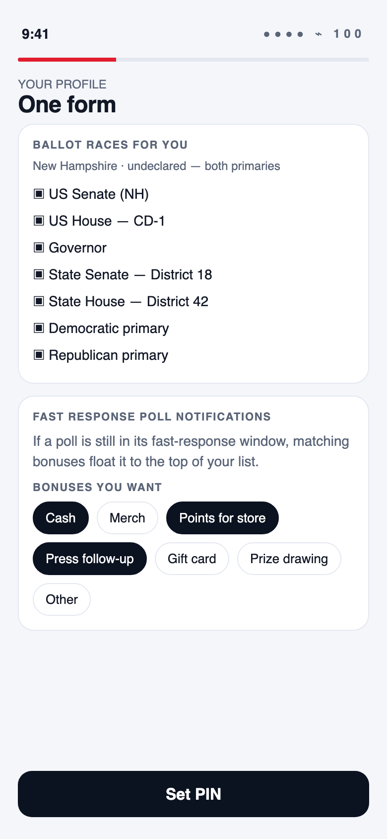
REGISTER · RACES AND BONUSES
Ballot races from ZIP + party. Undeclared sees both primaries. Fast-response bonuses are multi-select.
Races · Cash, points, press
PULSE POLLS · PRODUCT WALKTHROUGH · PROPRIETARY
09 / 24

Slide 10
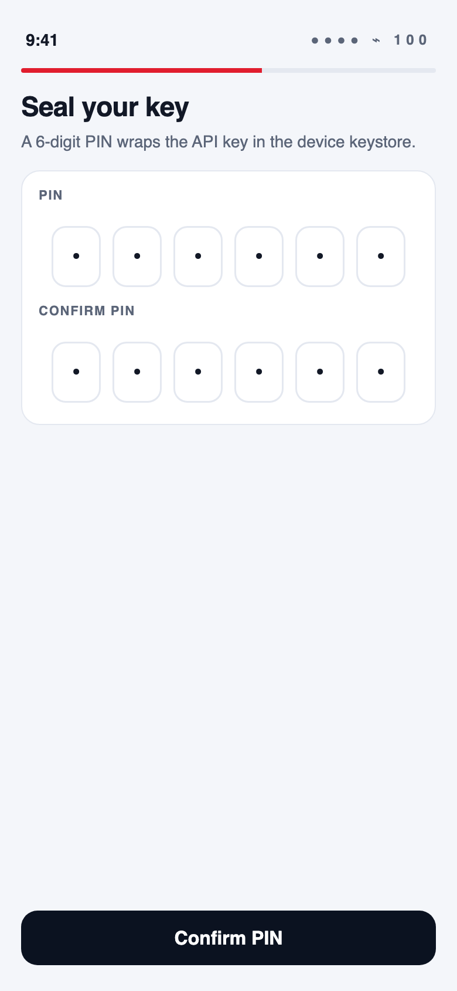
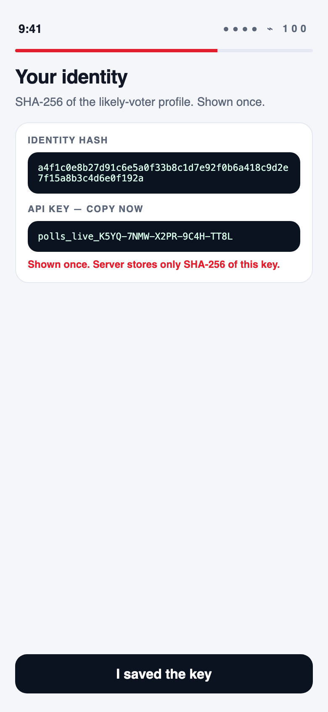
REGISTER · KEY
PIN wraps the key. Hash and API key shown once.
Seal the key
Hash + API key
PULSE POLLS · PRODUCT WALKTHROUGH · PROPRIETARY
10 / 24

Slide 11
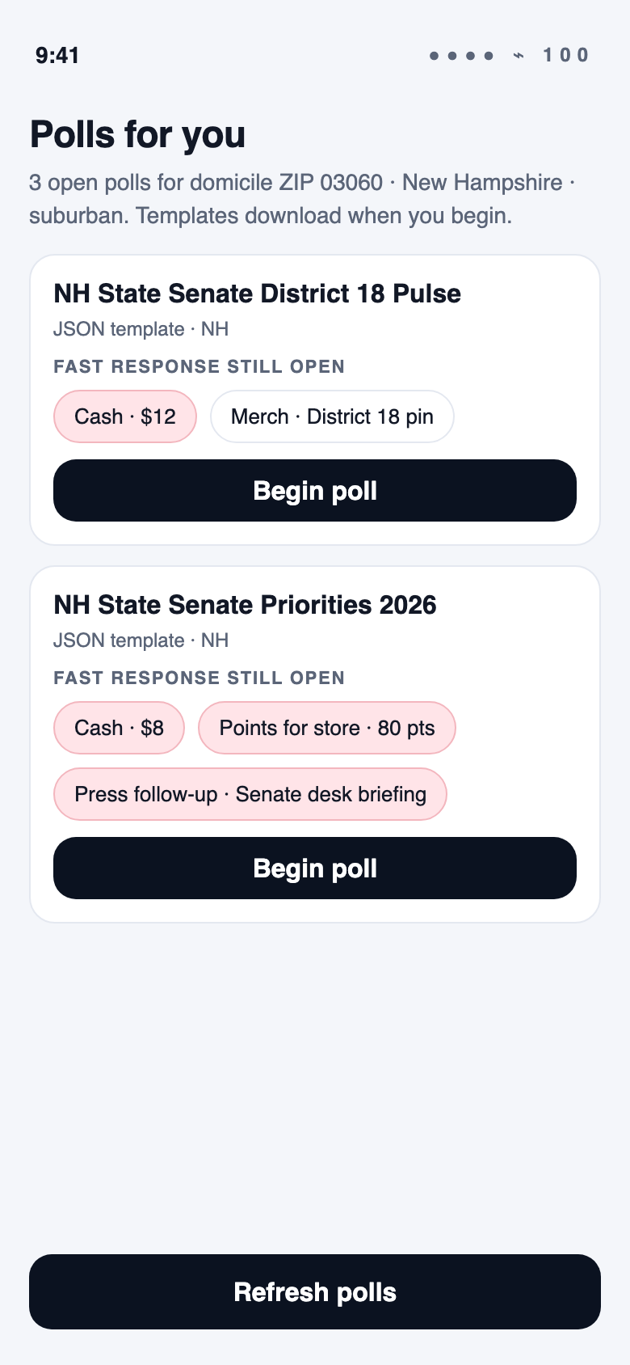
SELECT A SURVEY
Polls for you — ZIP-matched, remaining fast-response bonuses listed, preferred bonuses sort to the top.
Begin poll
PULSE POLLS · PRODUCT WALKTHROUGH · PROPRIETARY
11 / 24

Slide 12
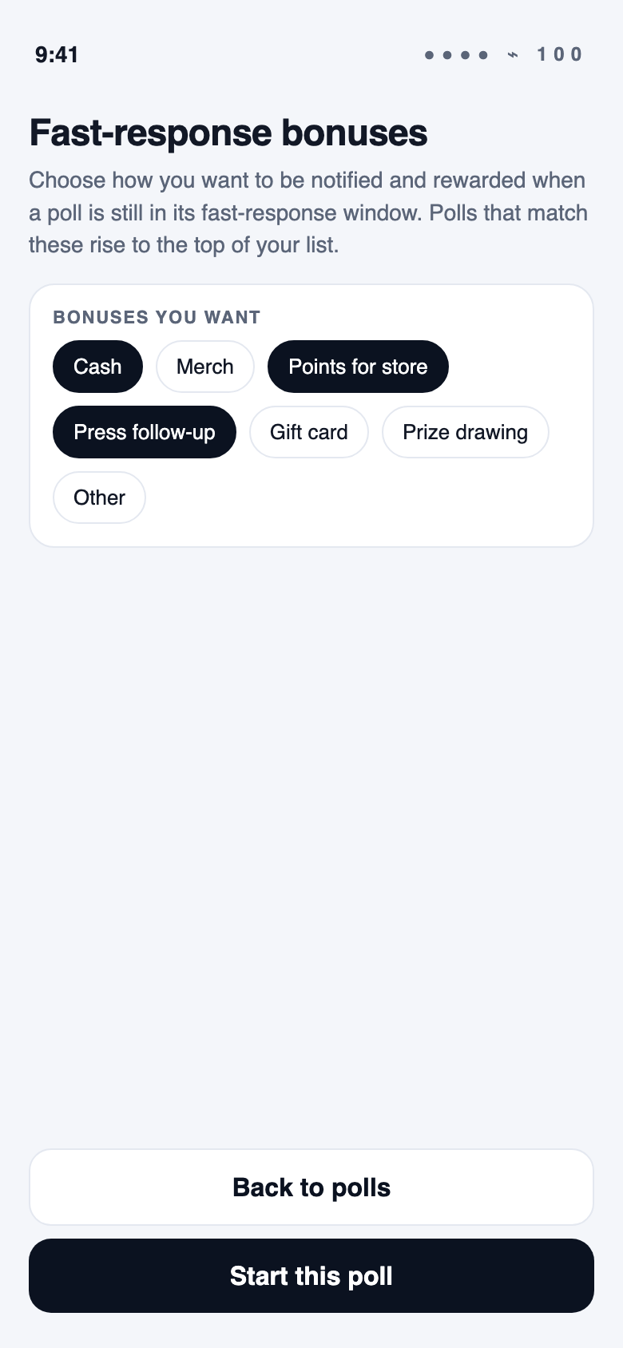
SELECT A SURVEY
If bonuses were not set on the profile, choose them here before the poll starts.
Fast-response bonuses
PULSE POLLS · PRODUCT WALKTHROUGH · PROPRIETARY
12 / 24

Slide 13
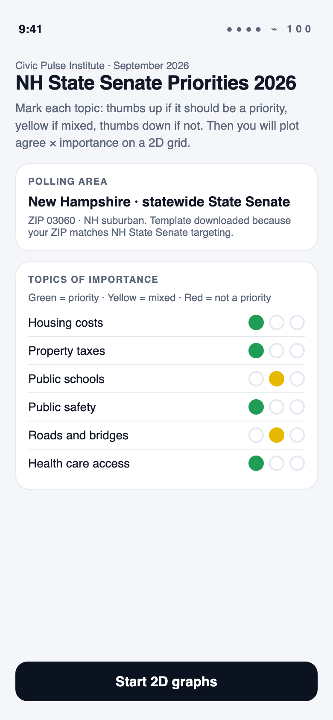
SURVEY · BRIEFING
Polling area, why this poll, thumbs on every topic, then the 2D grid example.
Start 2D graphs
PULSE POLLS · PRODUCT WALKTHROUGH · PROPRIETARY
13 / 24

Slide 14
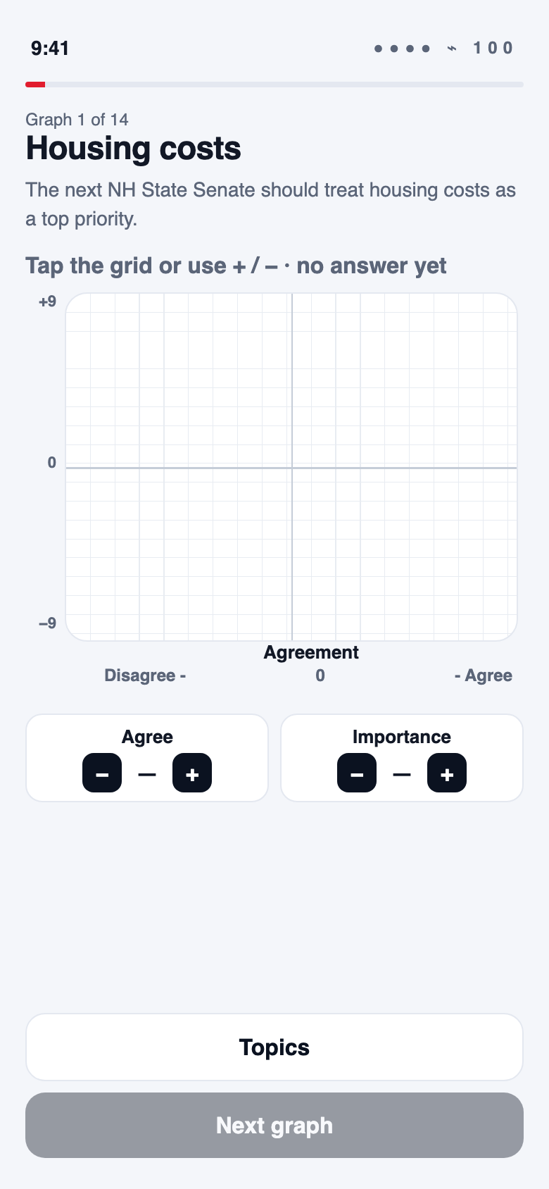
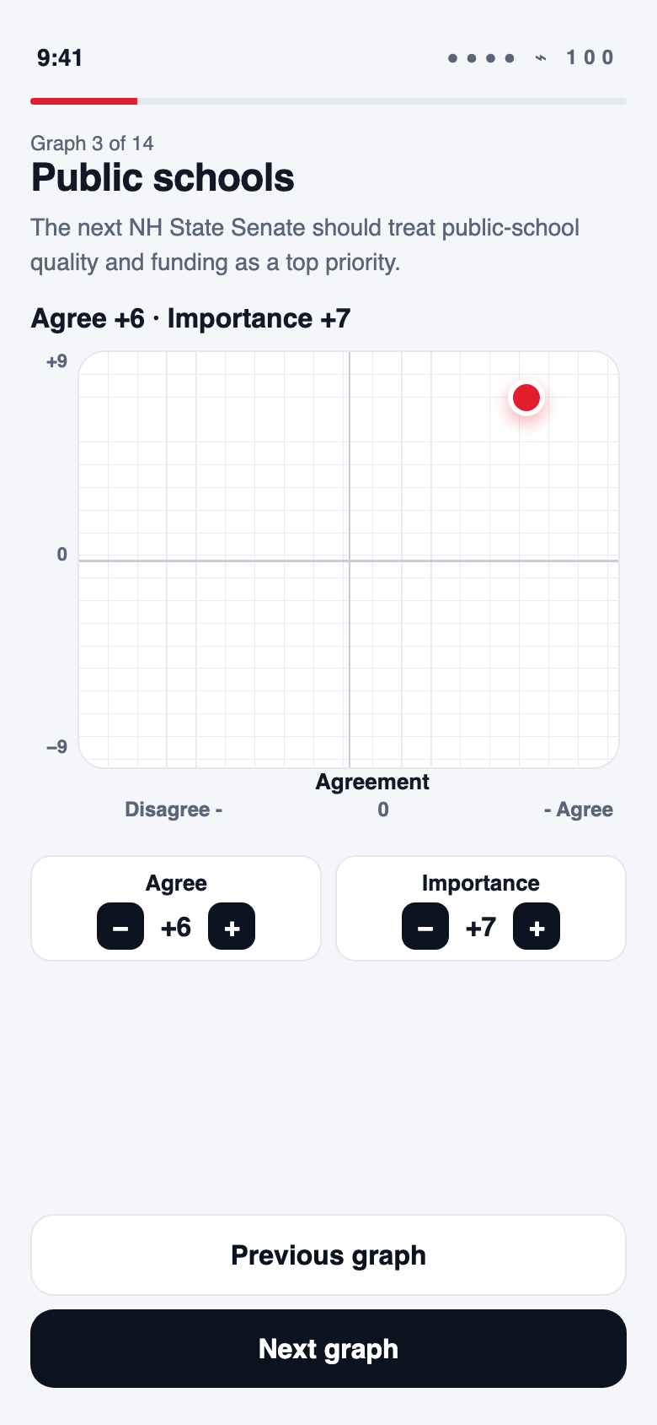
SURVEY · 2D GRAPH · 1 OF 14 … 14 OF 14
Agreement centered under the grid. Disagree − / − Agree. Importance is one word on the stepper.
Unanswered
Sample: agree +6 · importance +7
PULSE POLLS · PRODUCT WALKTHROUGH · PROPRIETARY
14 / 24

Slide 15
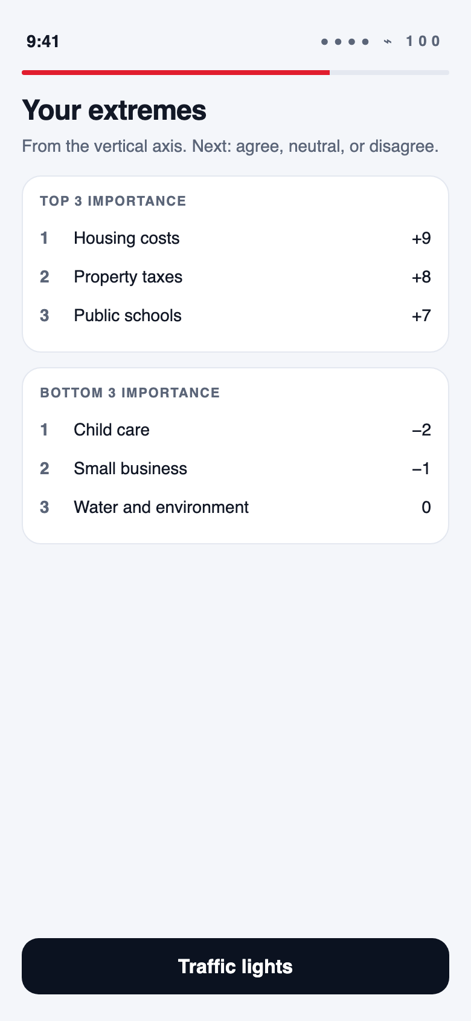
SURVEY · RANKS
The vertical axis fills disjoint top 3 and bottom 3 — never the same topic in both.
Your extremes
PULSE POLLS · PRODUCT WALKTHROUGH · PROPRIETARY
15 / 24

Slide 16
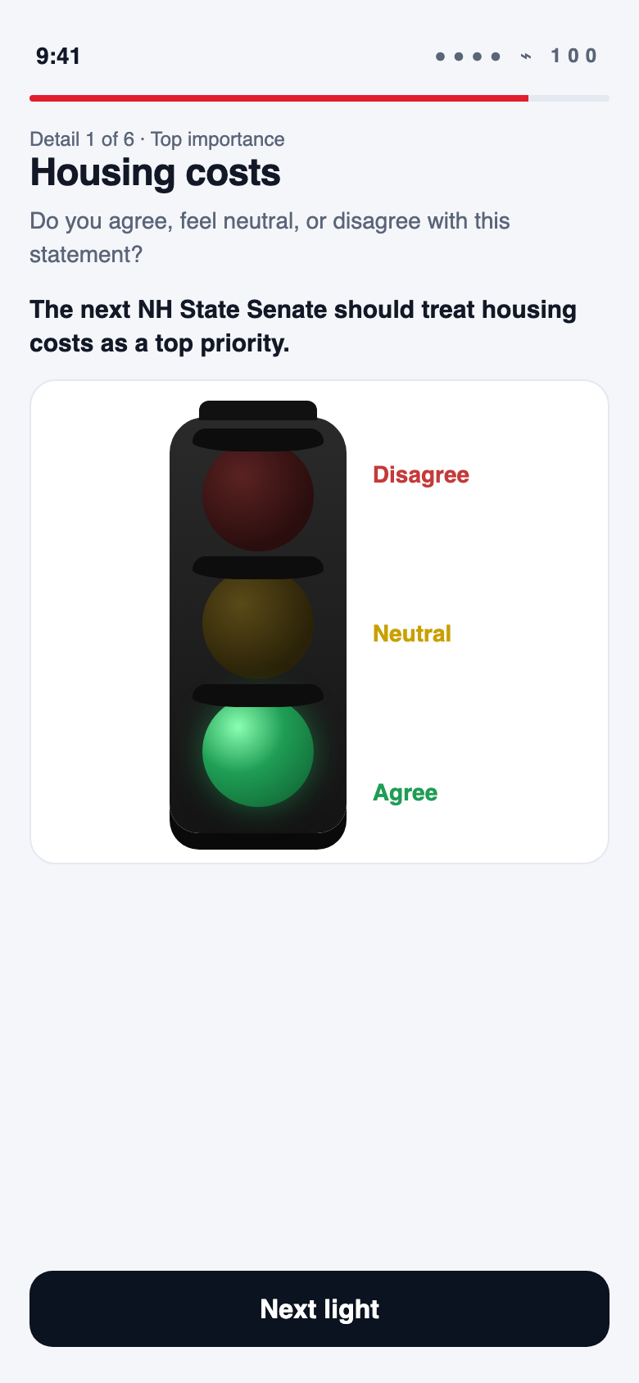
SURVEY · TRAFFIC LIGHT
Agree, neutral, or disagree — green / yellow / red on each extreme.
Detail 1 of 6 · Agree
PULSE POLLS · PRODUCT WALKTHROUGH · PROPRIETARY
16 / 24

Slide 17
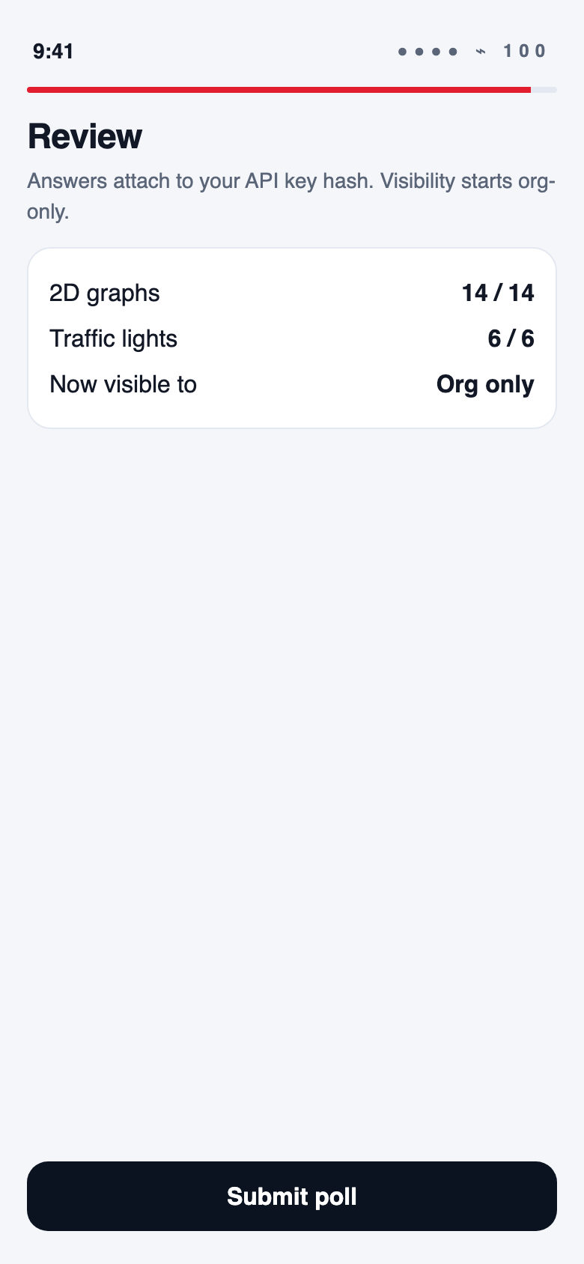
SURVEY · REVIEW
Submit stays locked until graphs and lights are complete. Visibility starts org-only.
14 / 14 graphs · 6 / 6 lights
PULSE POLLS · PRODUCT WALKTHROUGH · PROPRIETARY
17 / 24

Slide 18
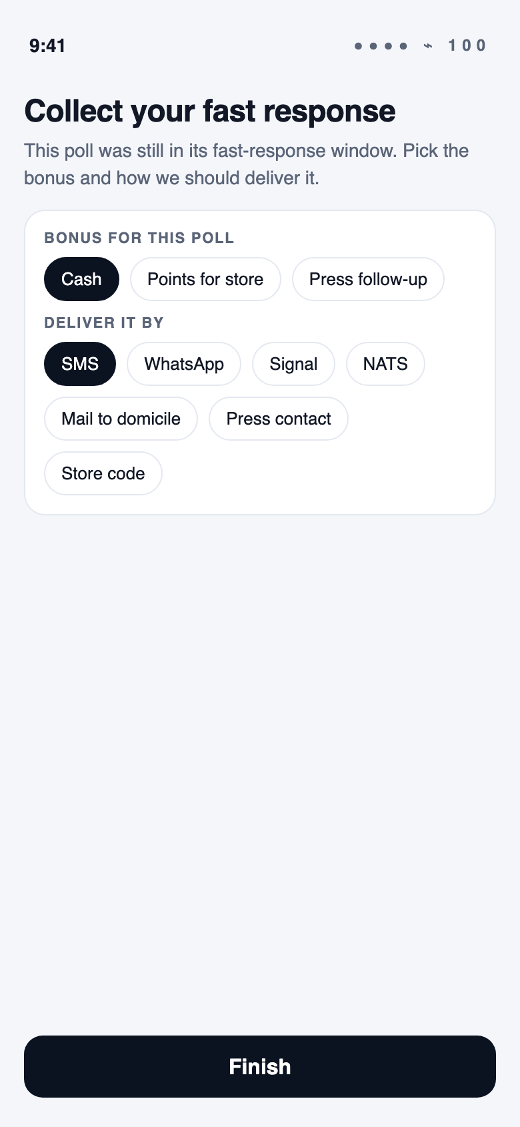
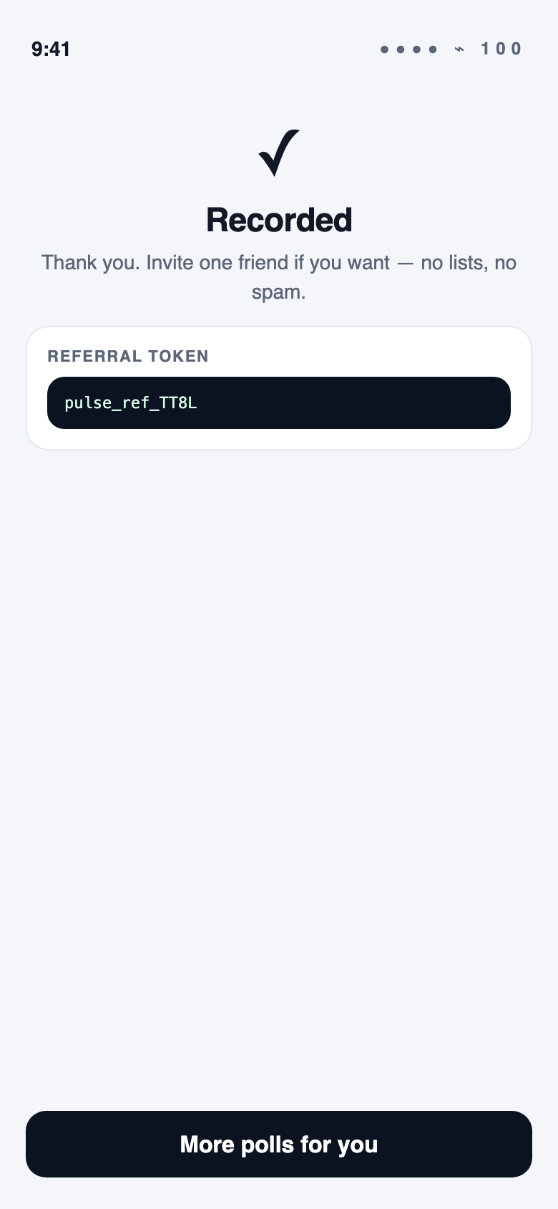
SURVEY · FAST RESPONSE AND DONE
If the window is still open, collect the bonus and delivery method. Then more polls for you.
Cash by SMS
Recorded
PULSE POLLS · PRODUCT WALKTHROUGH · PROPRIETARY
18 / 24

Slide 19
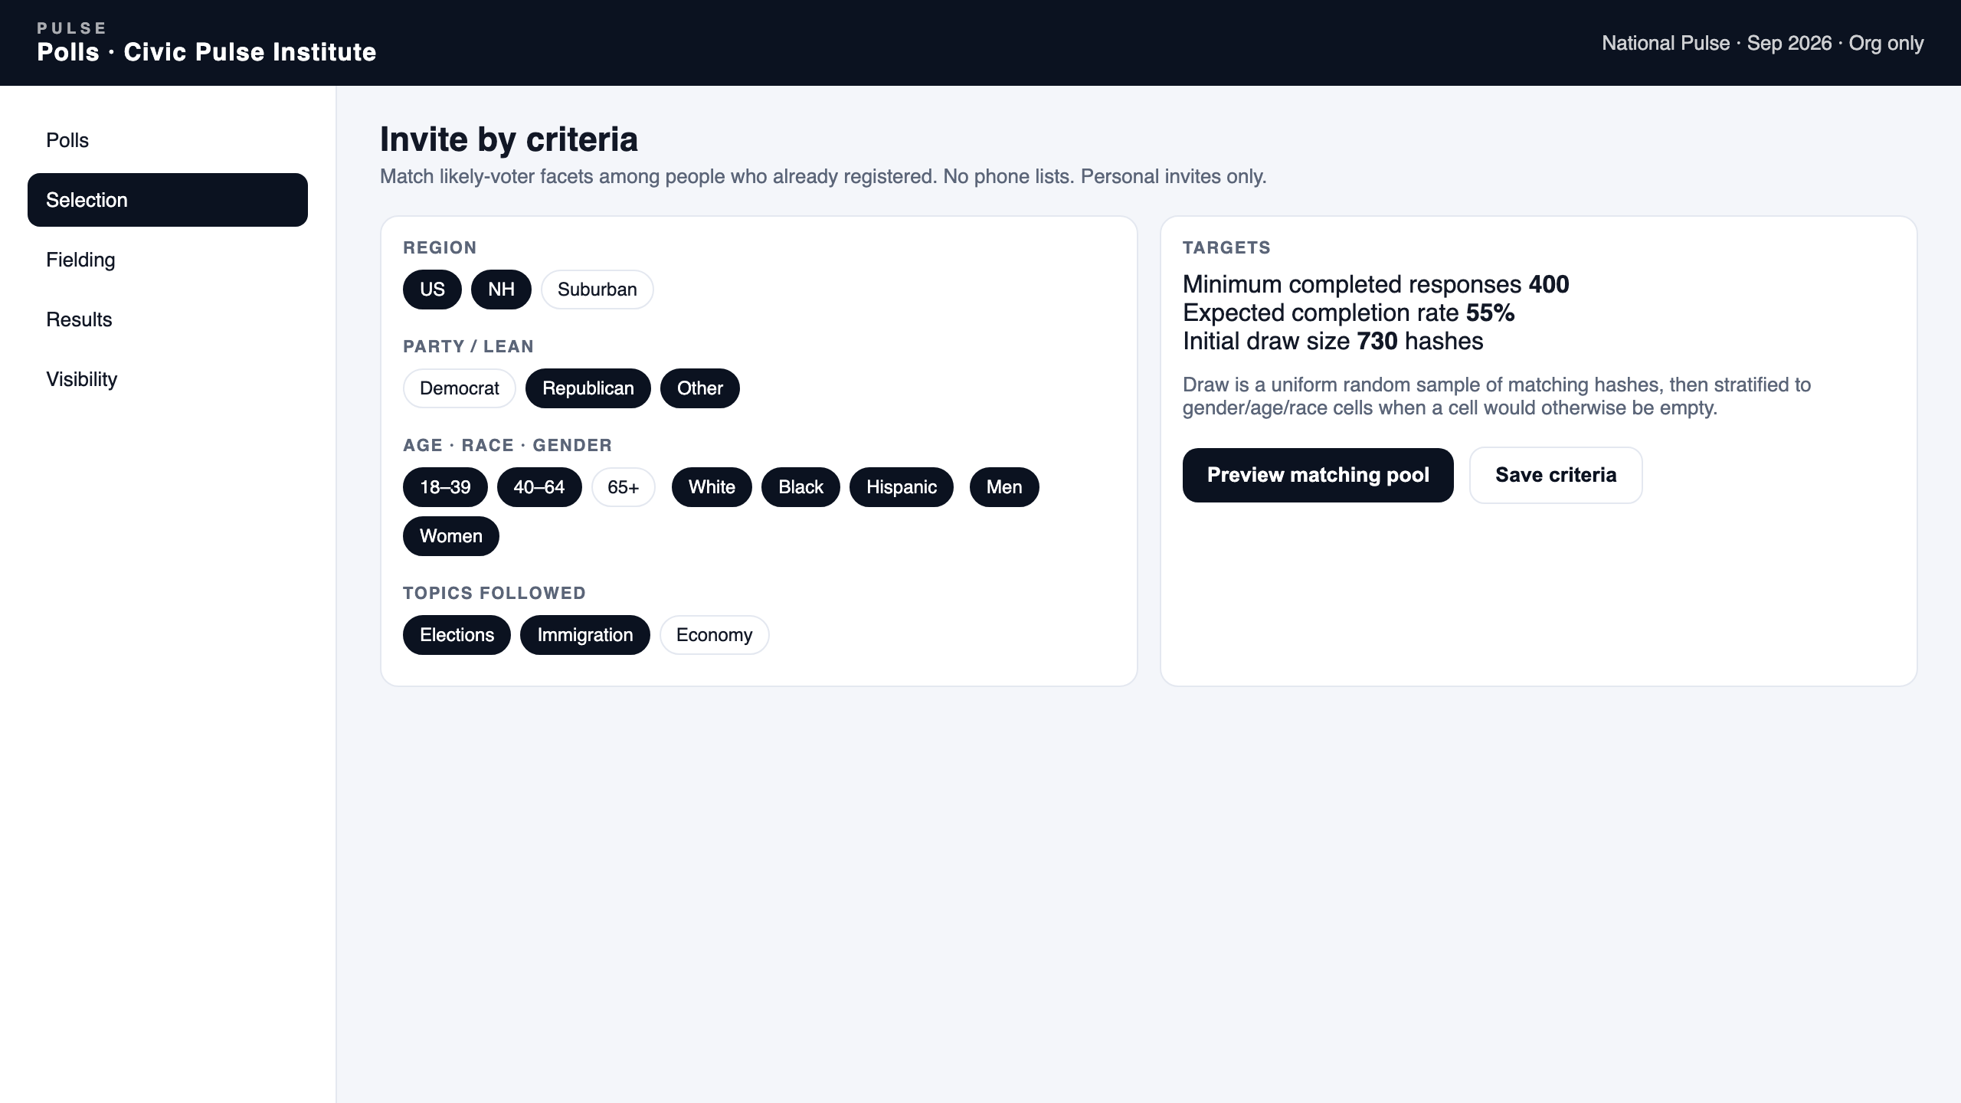
ADMIN · CRITERIA
The org filters people who already registered — never a purchased list.
PULSE POLLS · PRODUCT WALKTHROUGH · PROPRIETARY
19 / 24

Slide 20
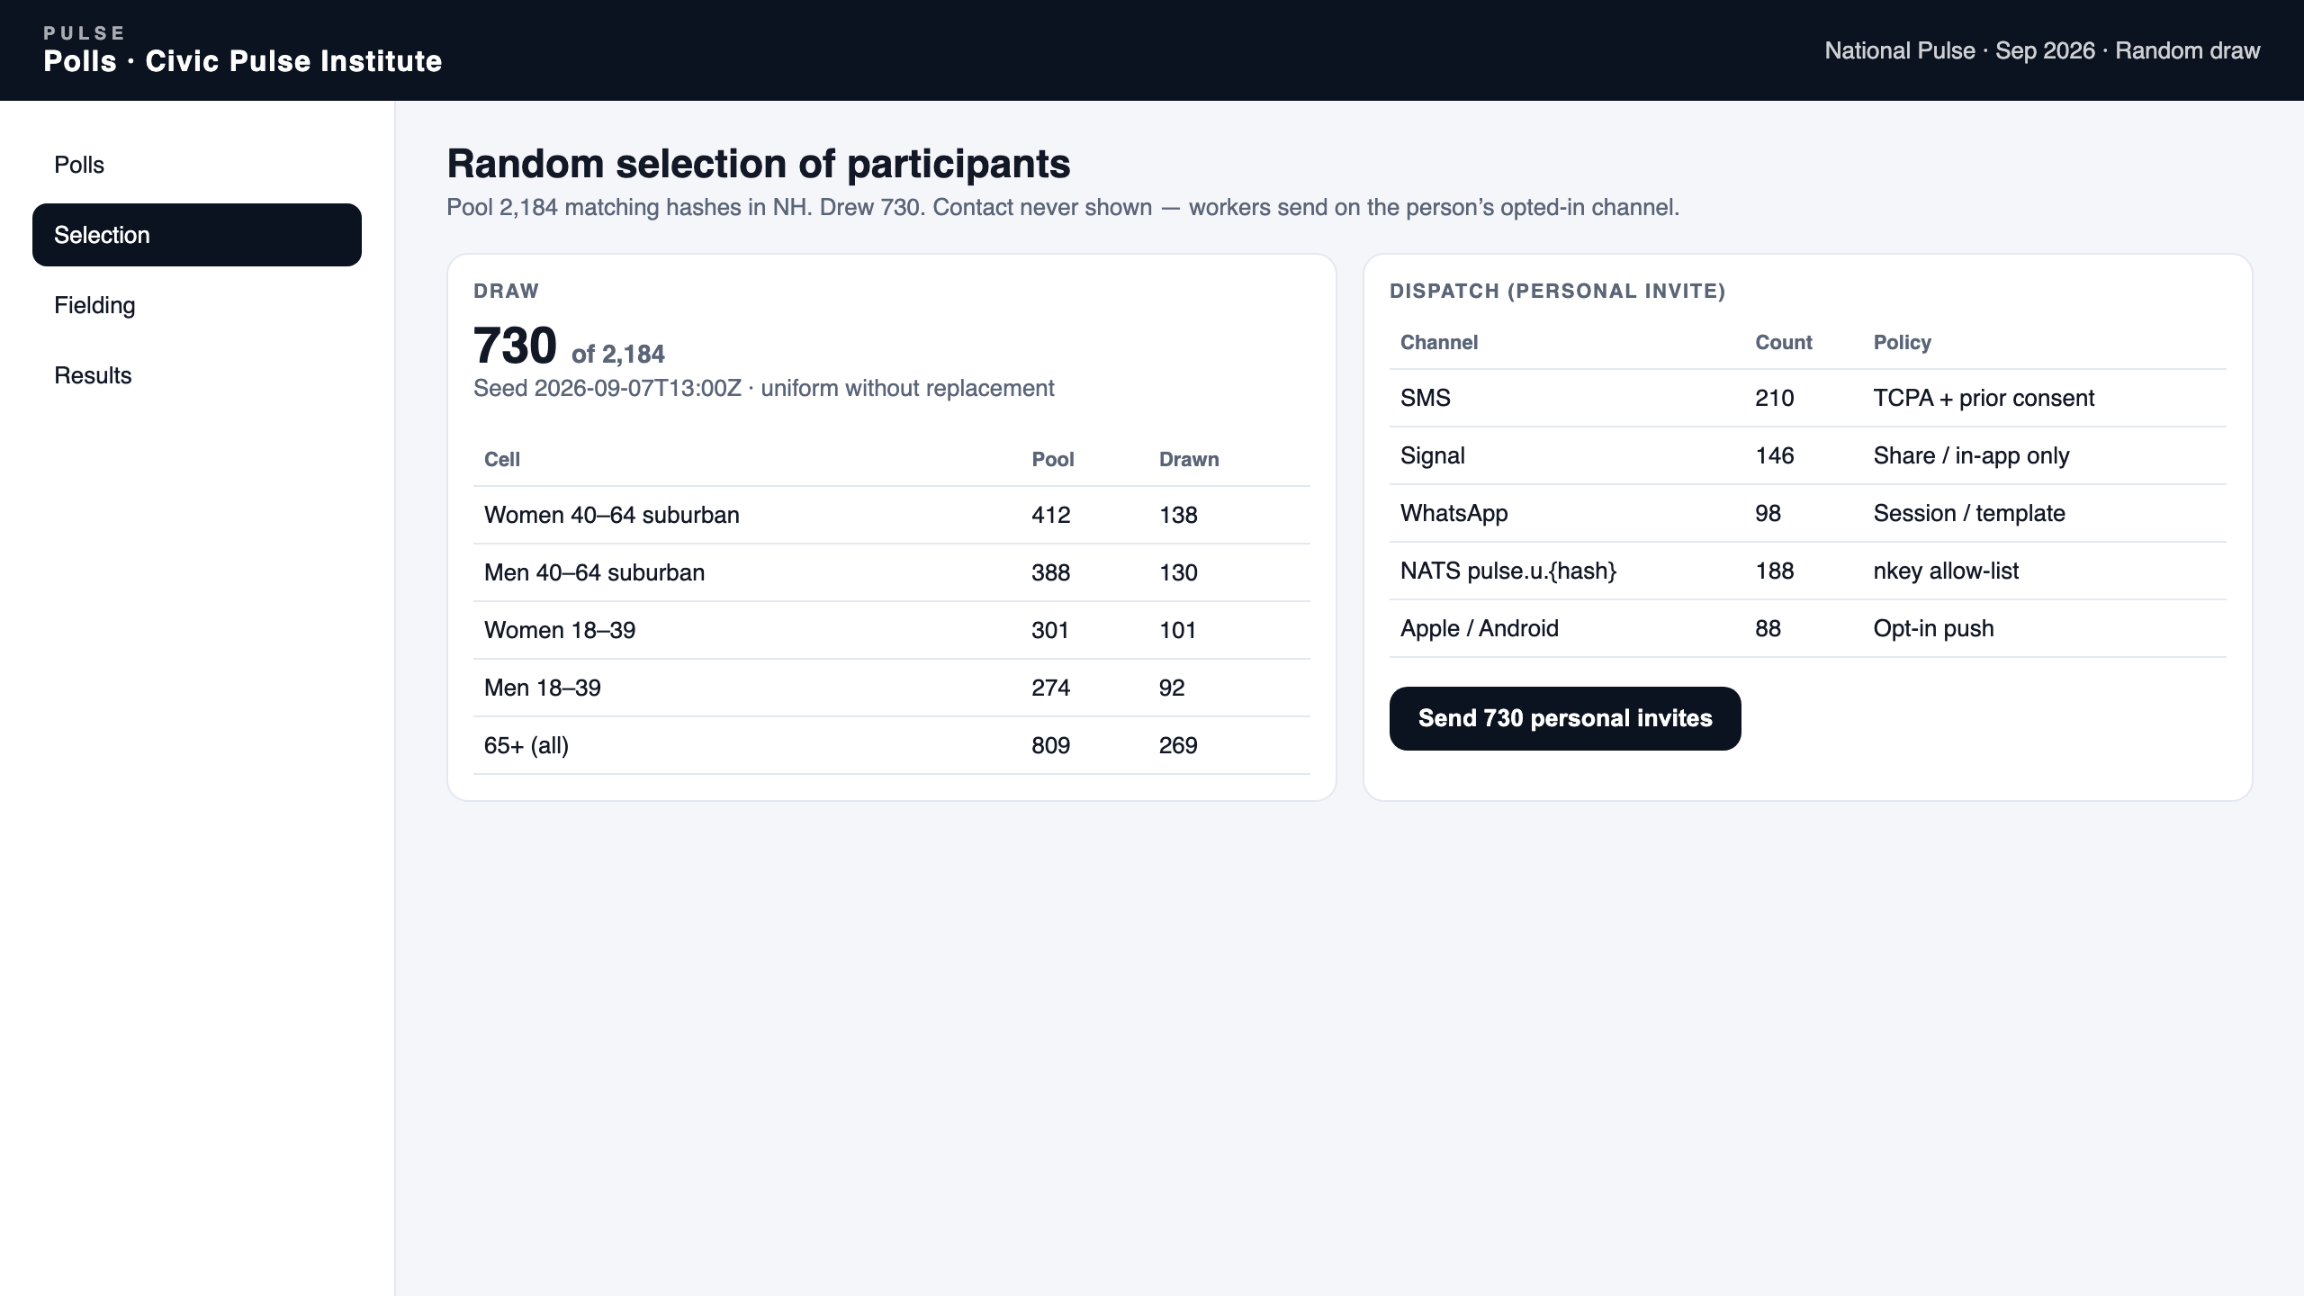
ADMIN · RANDOM DRAW
Uniform sample of matching hashes, then personal dispatch by opted-in channel.
PULSE POLLS · PRODUCT WALKTHROUGH · PROPRIETARY
20 / 24

Slide 21
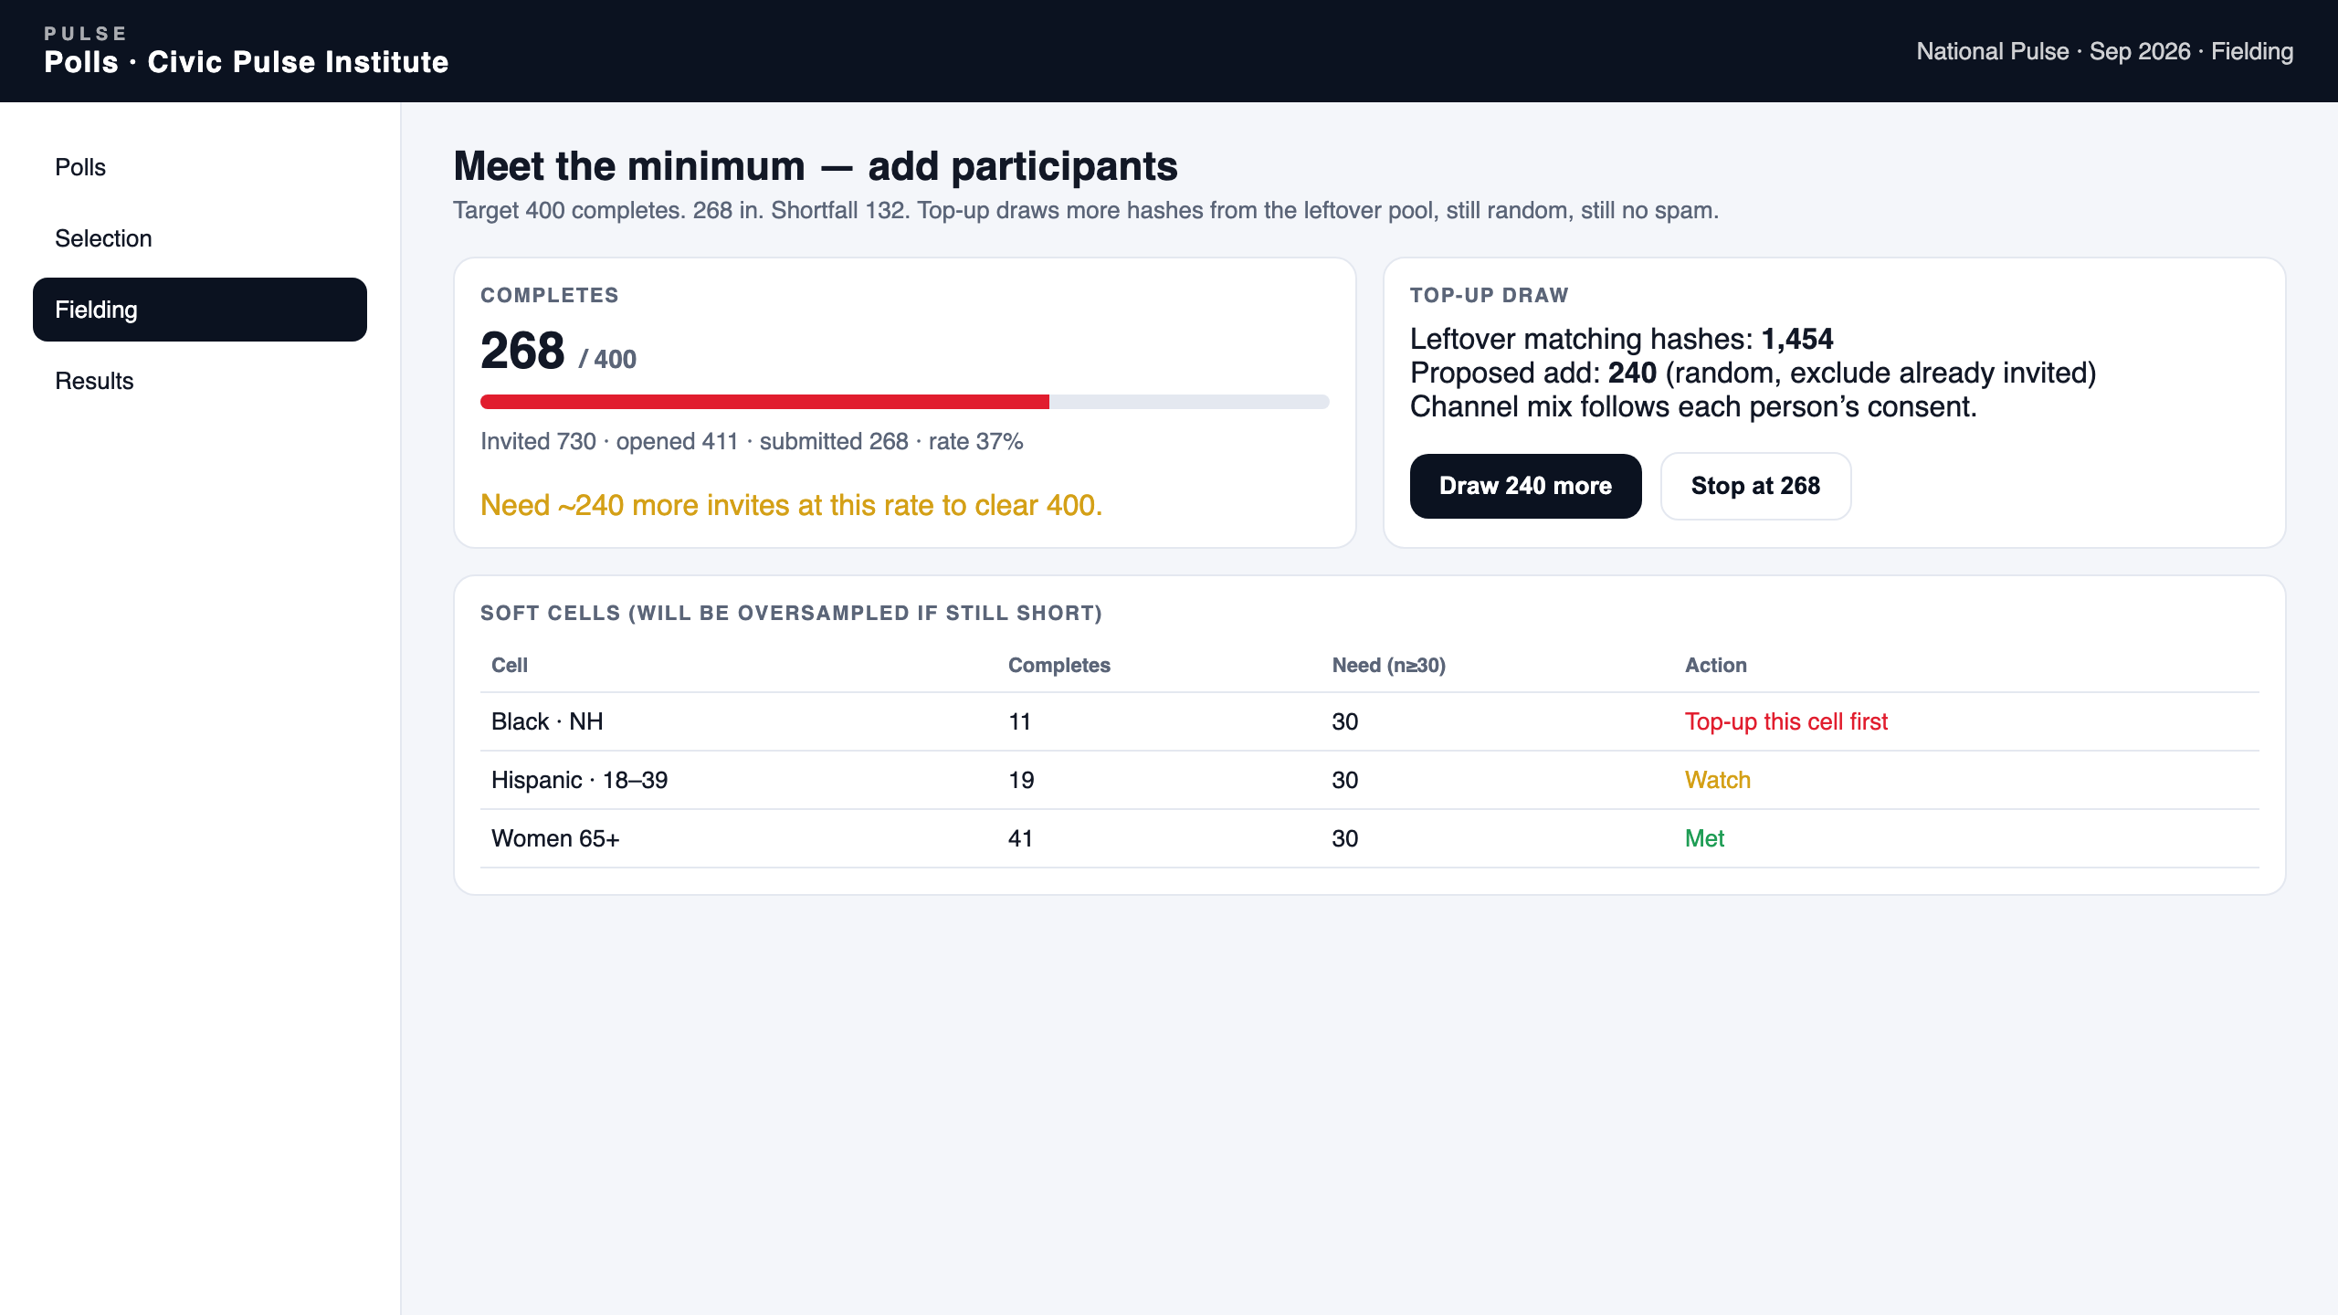
ADMIN · FIELDING
If completes lag the target, draw more from the leftover pool. Thin cells first.
PULSE POLLS · PRODUCT WALKTHROUGH · PROPRIETARY
21 / 24

Slide 22
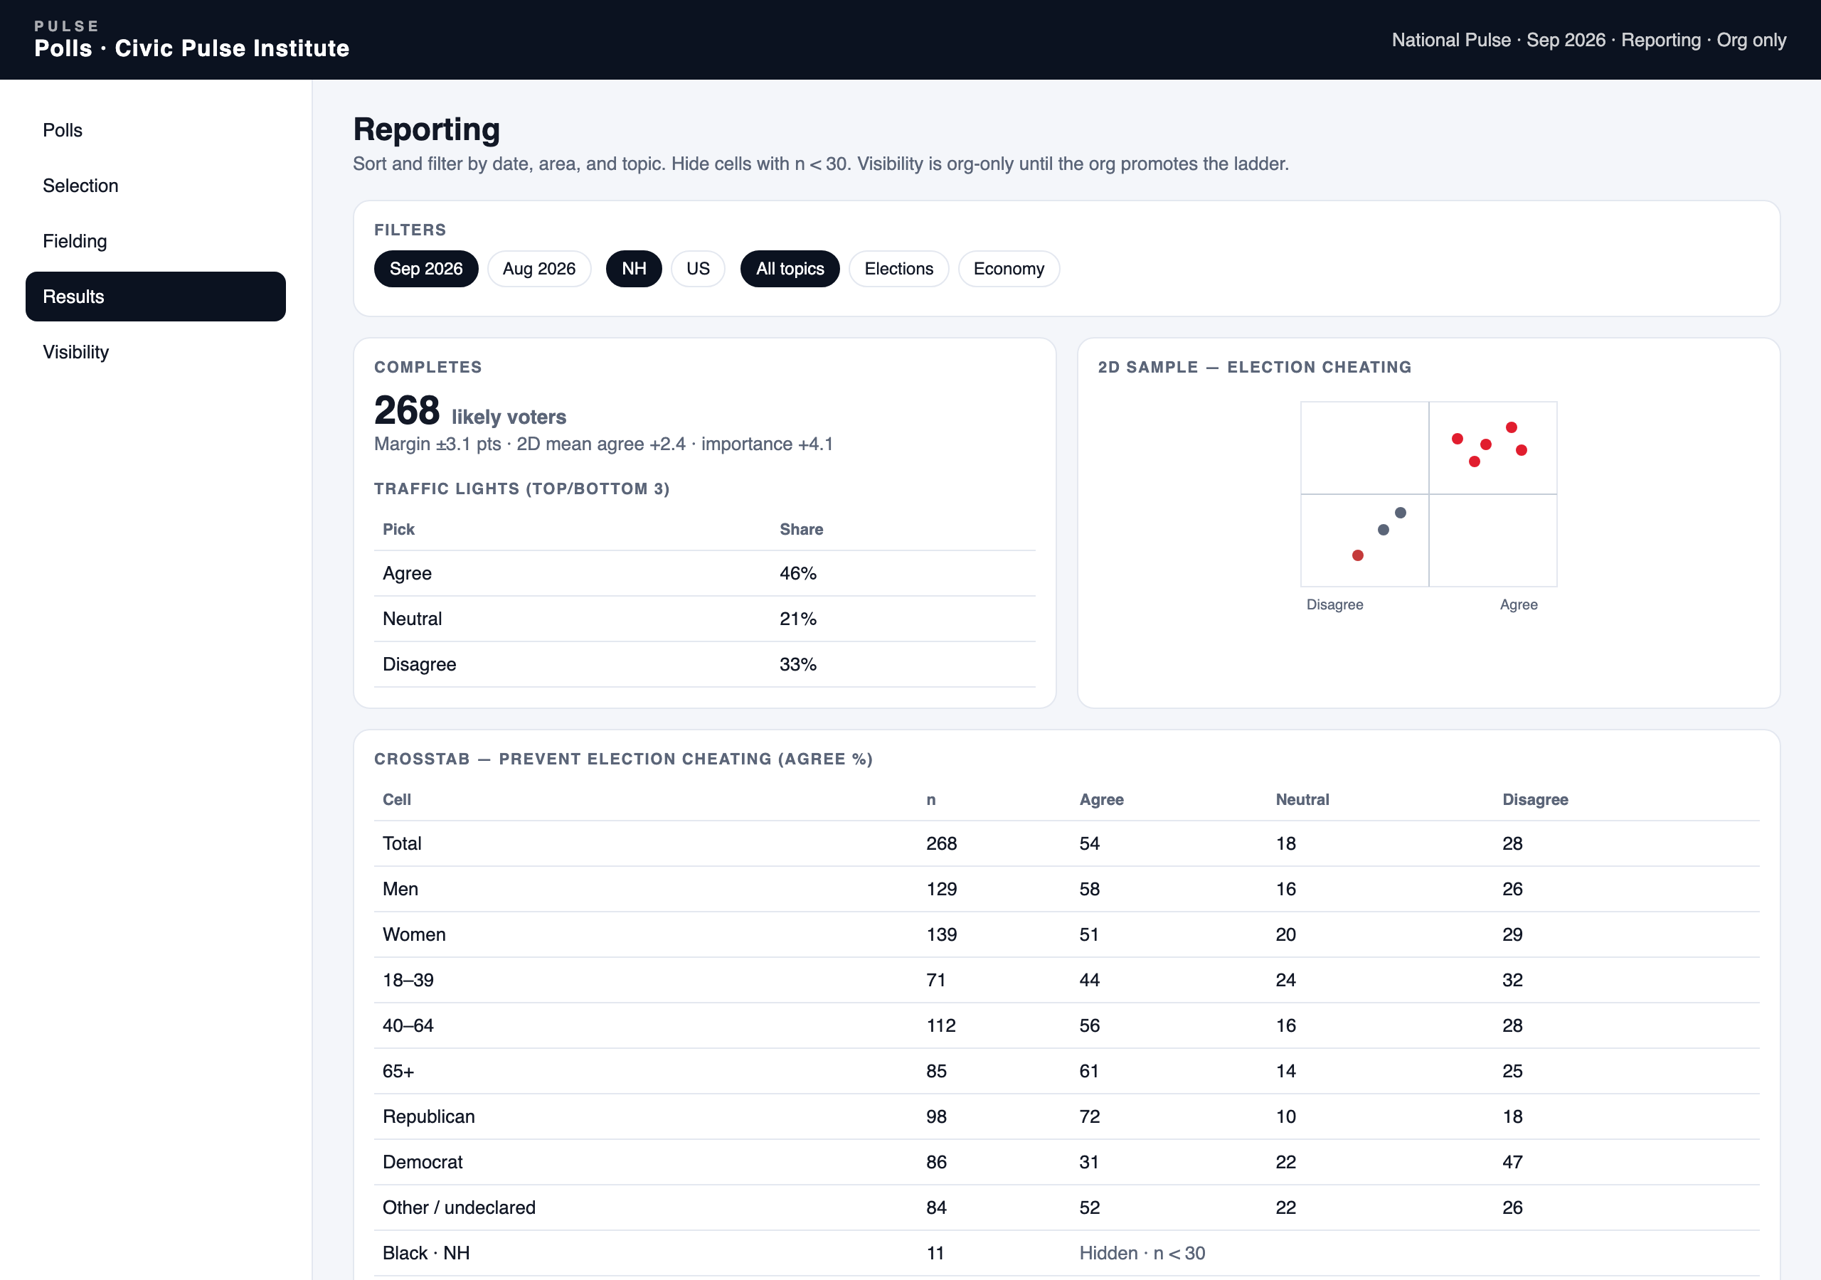
ADMIN · REPORTING
Summary, 2D scatter, and crosstabs. Cells with n < 30 are hidden.
PULSE POLLS · PRODUCT WALKTHROUGH · PROPRIETARY
22 / 24

Slide 23
AFTER SUBMIT
Results visibility is a one-way ladder owned by the tenant.
1
2
3
4
Org only
Invited people
Embargoed press
Public
Default. Members of the requesting org.
Named reviewers, still hashed. No public URL.
Approved press list, watermarked, clocked.
Sort by date, area, topic. Hide cells with n < 30.
PULSE POLLS · PRODUCT WALKTHROUGH · PROPRIETARY
23 / 24

Slide 24
LIVE SITES
The walkthrough is the product, not a wireframe of a future app.
Pitch · surveypitch.georgelambert.org
Admin / reporting · surveyadmin.georgelambert.org
Setup gallery · surveysetup.georgelambert.org
Demo · surveydemo.georgelambert.org
Deck file: Pulse-Polls-Product-Walkthrough.pptx · Proprietary
PULSE POLLS · PRODUCT WALKTHROUGH · PROPRIETARY
24 / 24

